Slide 1
Comparing the Obesity and Poverty Rates by State and County in the Unites States
Irwin Bahande Mier, Kim Rones, Jeff Hartung, Nicholas DiBiase

Slide 2
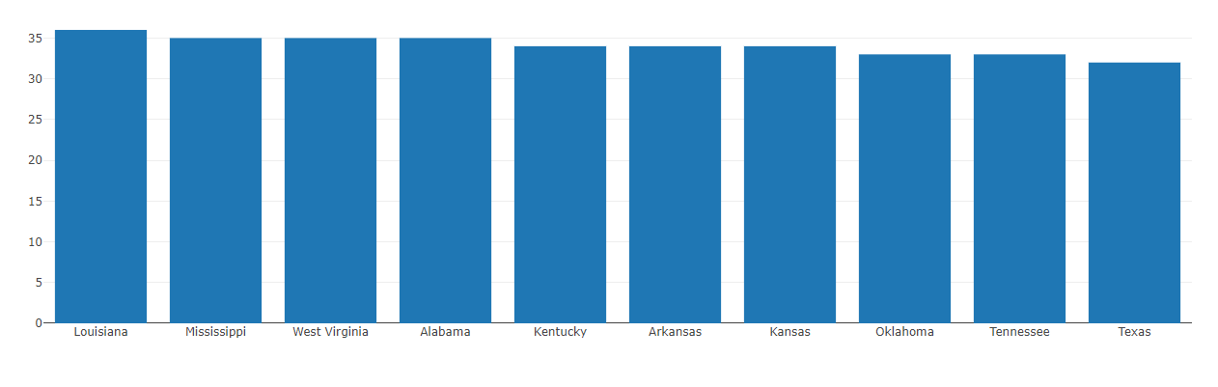
Top Ten obese states

Slide 3
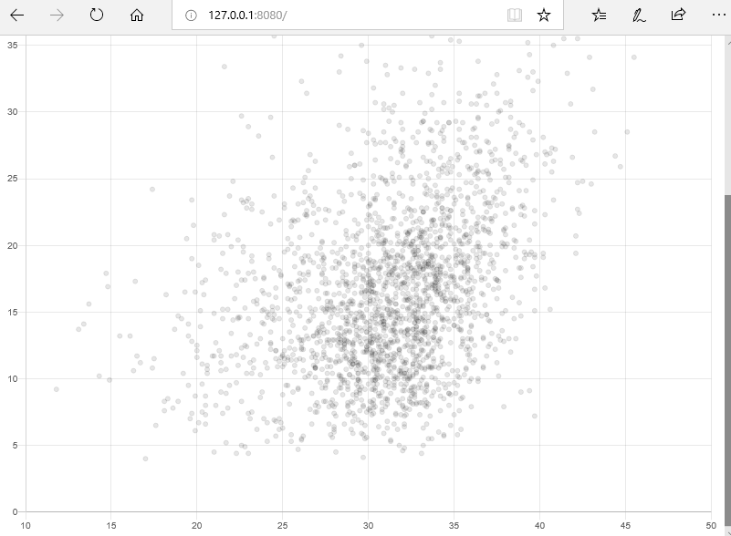
Obesity vs Poverty Rate by US County

Slide 4
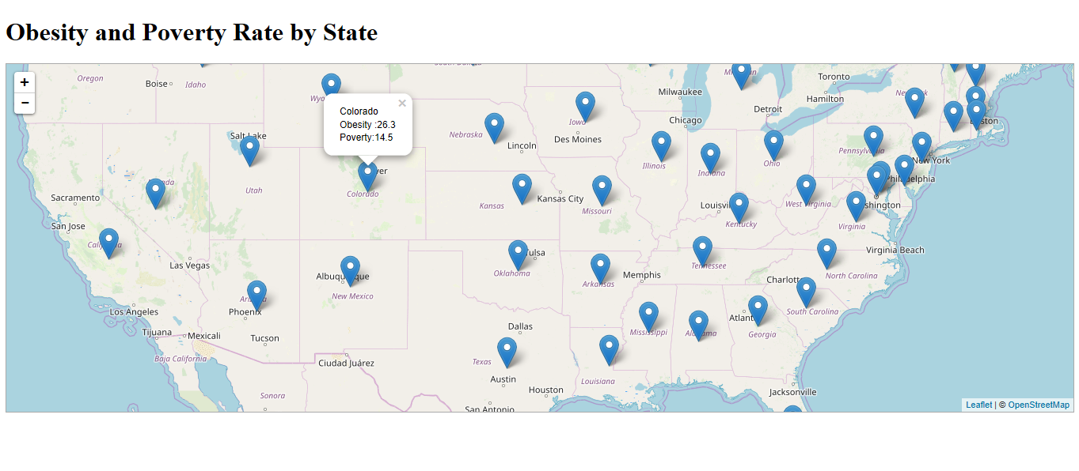

Slide 5
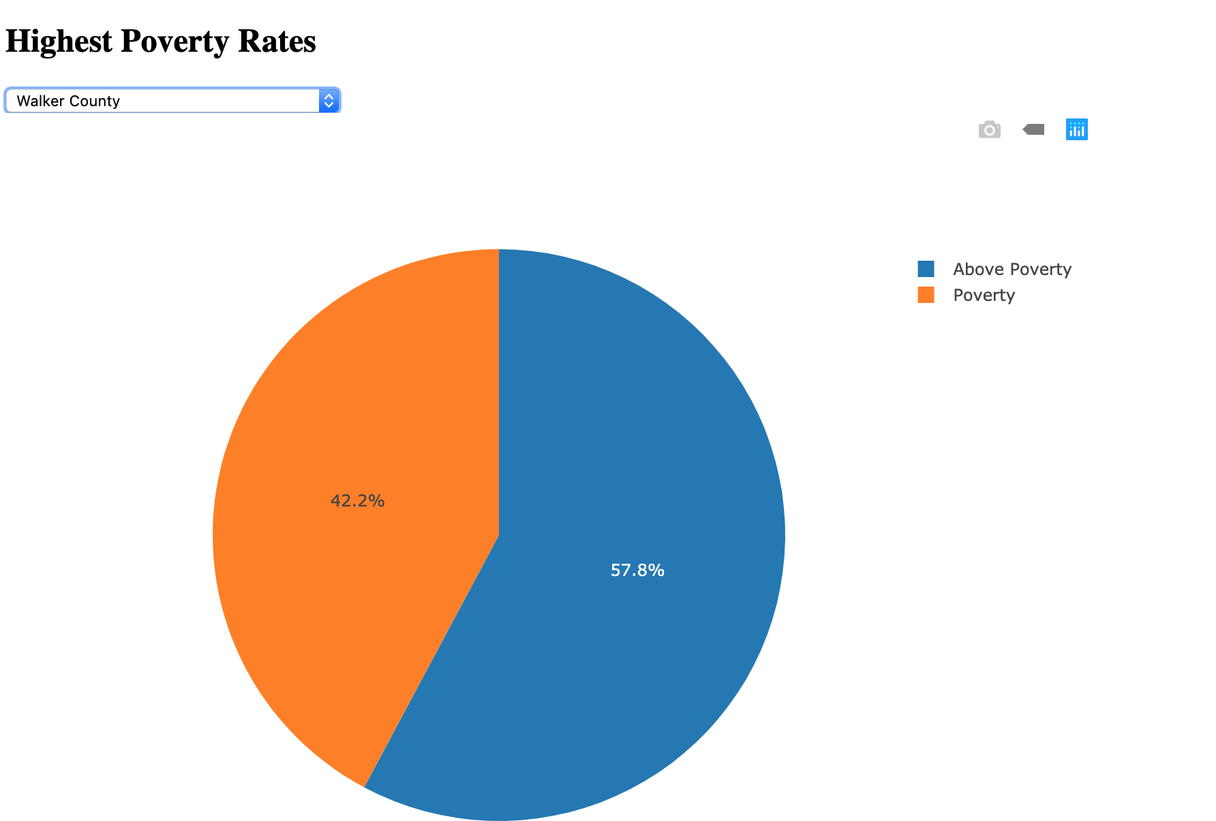

Slide 6


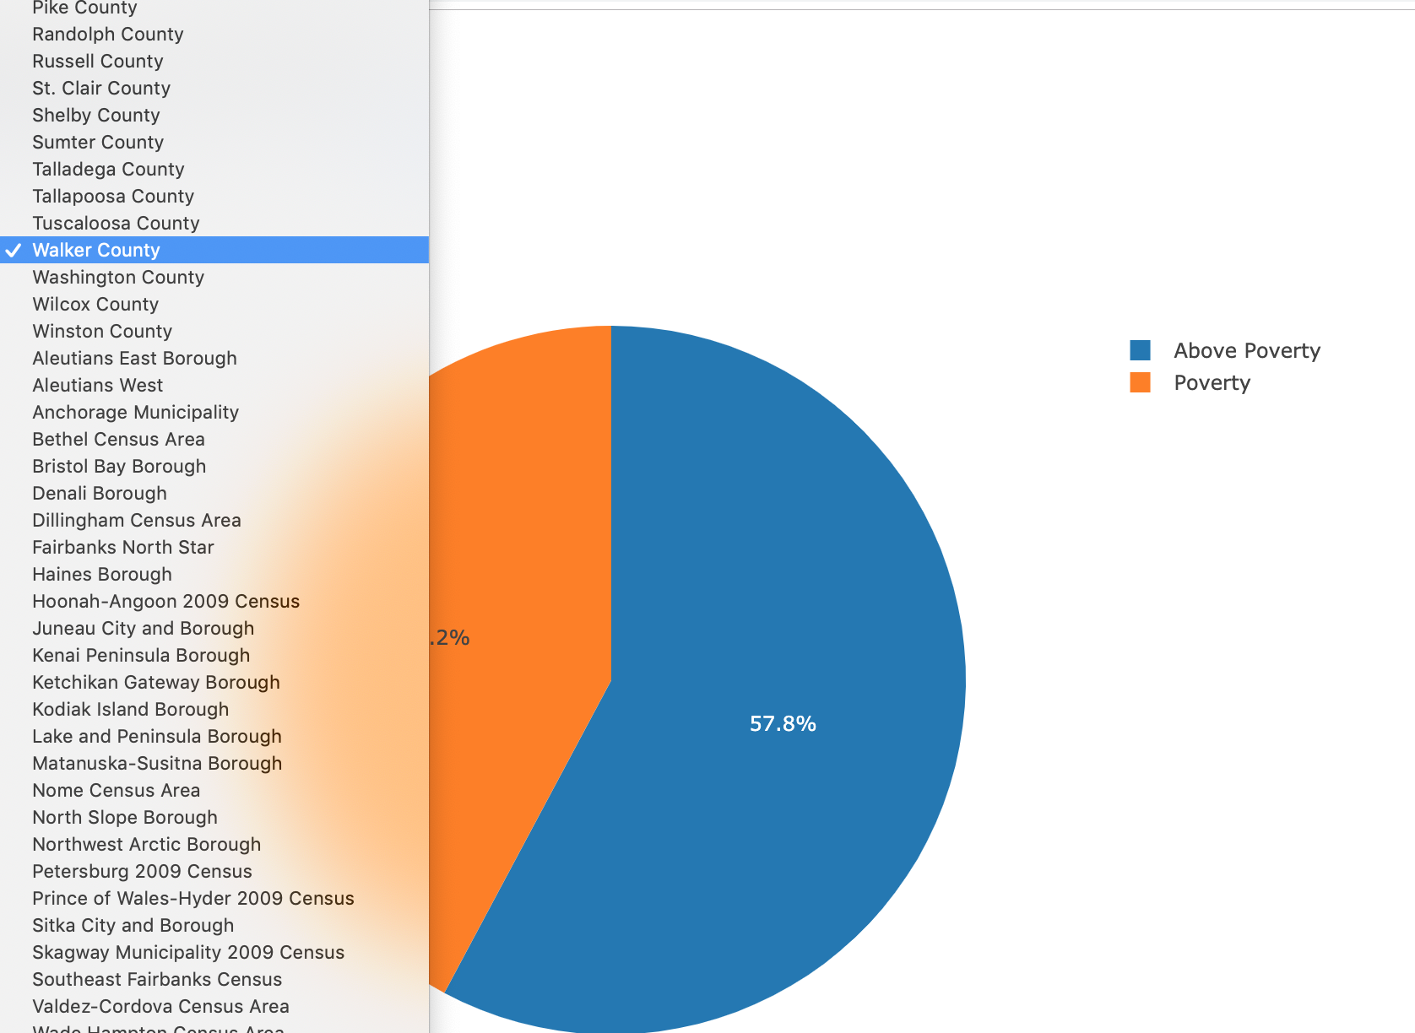

Slide 7
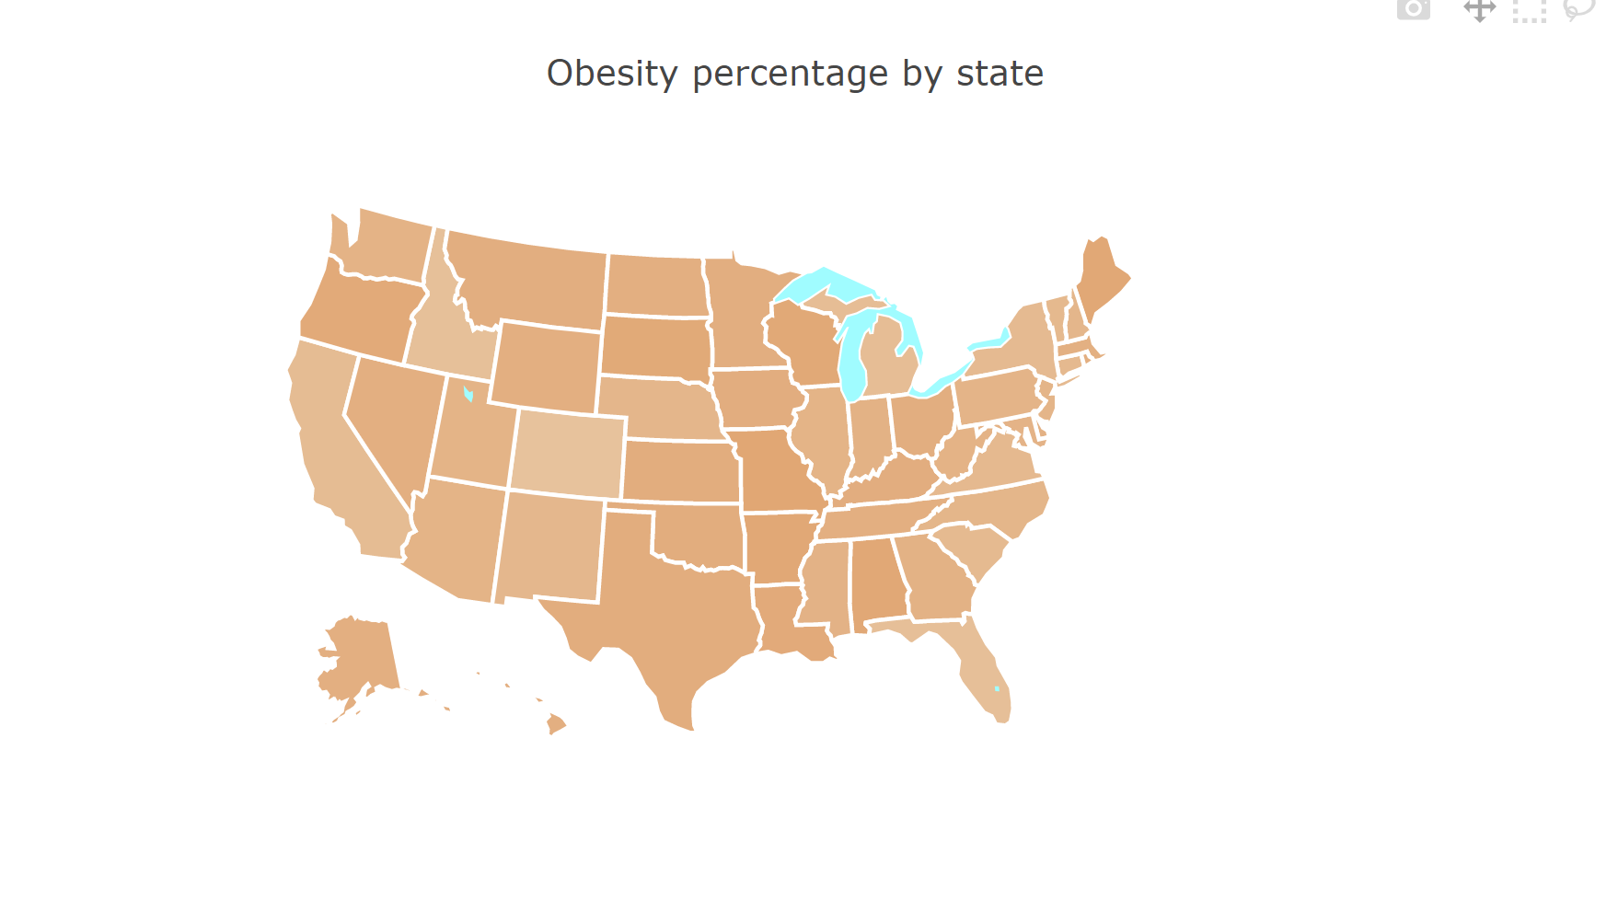

Slide 8
